Slide 1
Report from Italy during the time of SARS-CoV-2, Part 2
(Apologies to Gabriel Garcia Márquez)
John H. Holmes, PhD
Professor of Medical Informatics in Epidemiology
University of Pennsylvania Perelman School of Medicine
Visiting Professor, University of Pavia, Italy

Slide 2
We will have time for discussion!
Please add your questions in the chat box

Slide 3
A quick review…

Slide 4
Features of COVID-19
In most people, it causes few, if any symptoms
Data from a town in Italy indicate 60-70% of those testing positive are asymptomatic throughout their course
In others, the disease is devastating
Cascade of system compromise, involving lungs, heart, kidneys

Slide 5
Treatment of COVID-19: In the early stages…
Until someone tests positive, assume one with symptoms is positive and self-quarantine.

Slide 6
As COVID-19 progresses
Most (~80%) will experience a flu-like syndrome that lasts 10-14 days and can rest at home (in quarantine, of course!)
Others (elders, immunocompromised, those with significant comorbidities)
Usually hospitalized after triage
Most will be discharged after 7-10 days to quarantine at home
Some will end up in the ICU

Slide 7
To bring everyone up to speed on the epidemiology
Epidemiologists and public health professionals are using tools to identify, contain, and mitigate the spread
Epidemic curves are indispensable in understanding the incidence and the rate of transmission
Can inform inference about mode of transmission, identification of hot spots, development of containment and mitigation policies and procedure, and resource allocation
They work particularly well for contained outbreaks

Slide 8
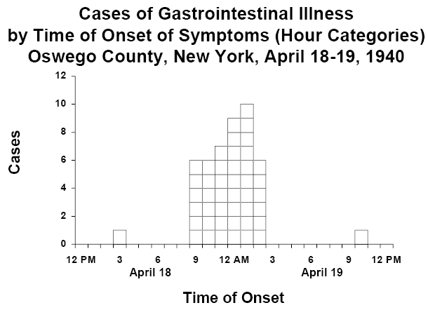
A classic example…
http://www.cdc.gov/eis/casestudies/xoswego.401-303.instructor.pdf

Slide 9
A problem with epidemic curves frequently used for COVID-19
Long incubation period
Low testing rate in most countries
Testing dependent on symptoms or even advanced disease state
Possible problem with false negatives
Long backlogs
Swabs batched at testing sites
Swabs batched at labs
Reagent shortages
Easier to run the PCRs in batch
Reporting to public health agencies is batched
Epi curves represent only resulted tests, not when swabs were collected from patients
Inaccurate picture of the dynamics of the pandemic

Slide 10
So, to repeat….
The COVID-19 epidemic curves represent only resulted tests, not when swabs were collected from patients
Most curves represent cumulative incidence, not daily incidence
As a result, the curves give an inaccurate picture of:
Incidence at given points in time
The dynamics of the pandemic
But they are still useful!

Slide 11
Here’s an alternative curve design

Slide 12
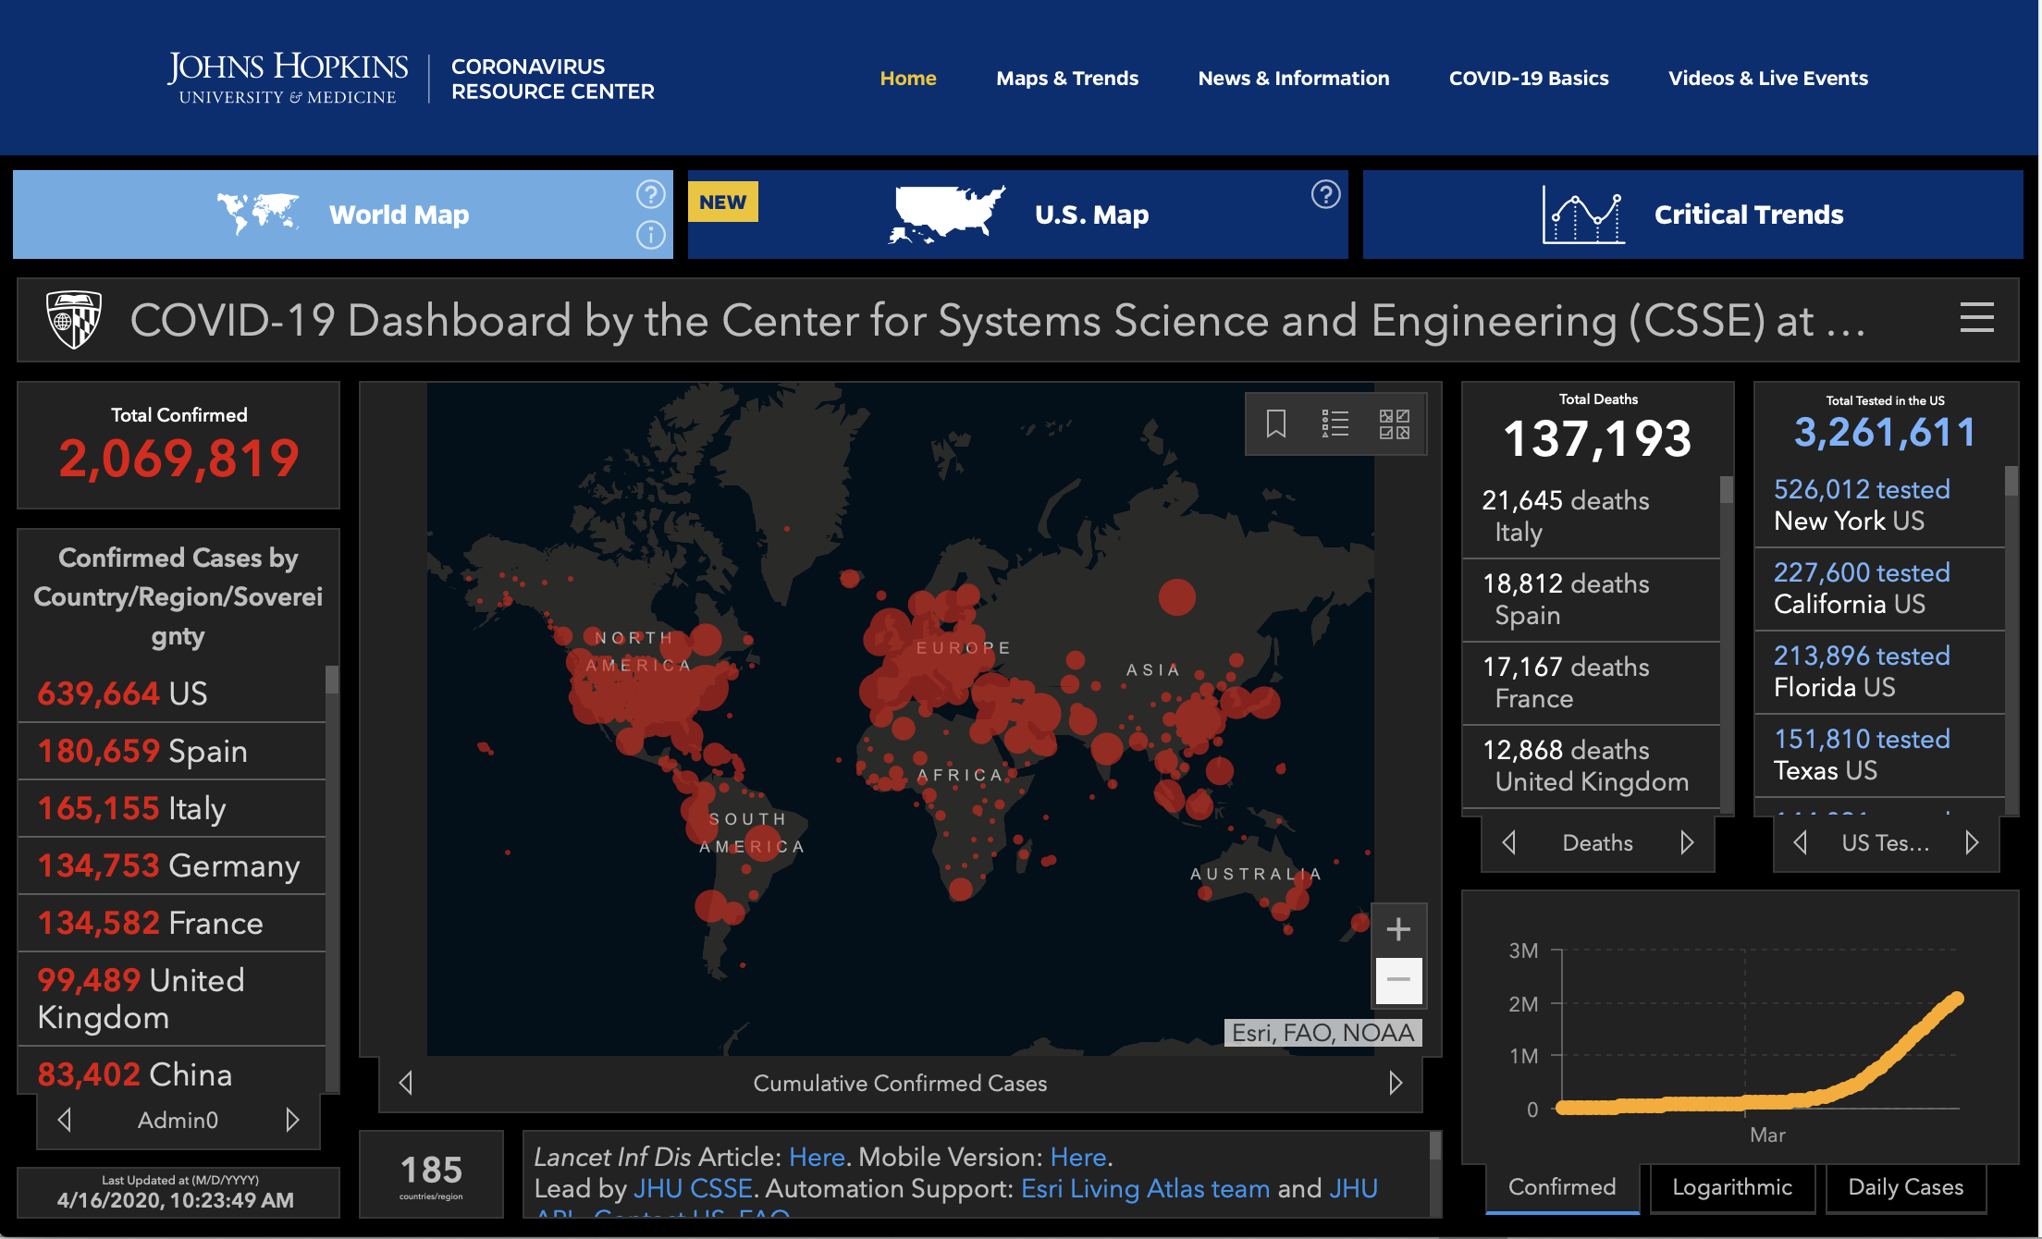
Where we are now globally https://coronavirus.jhu.edu/map.html

Slide 13
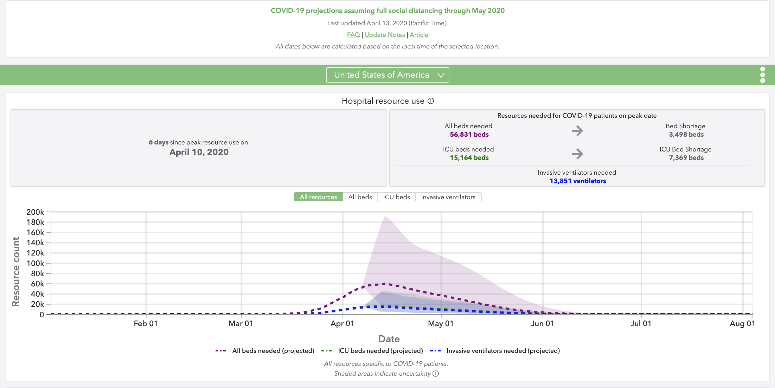
Another useful modeling site https://covid19.healthdata.org/united-states-of-america

Slide 14
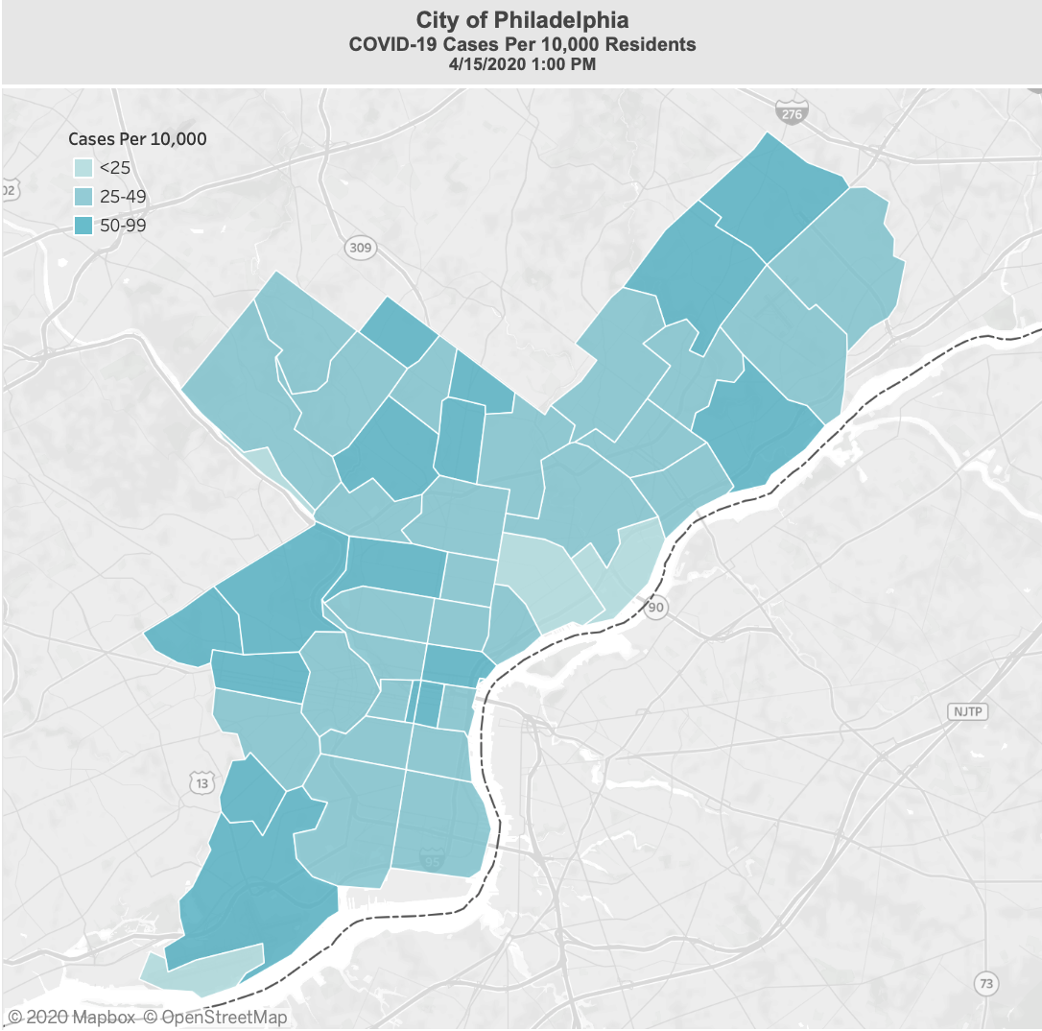
How about Philadelphia? https://www.phila.gov/programs/coronavirus-disease-2019-covid-19/testing-and-data/

Slide 15
Current flattening status for six countries
https://www.statista.com/chart/21112/covid-19-growth-curve-selected-countries/

Slide 16
So, back to Italy
Most indicators continue to climb
Number on home quarantine
Number of currently positive patients
Number dismissed from care and cured
Number of decedents
Total number of cases since testing started
But some are declining
Number of patients in ICU
Number recovering with symptoms
https://lab.gedidigital.it/gedi-visual/2020/coronavirus-i-contagi-in-italia/?ref=RHPPTP-BH-I250745935-C12-P8-S1.3-T1

Slide 17
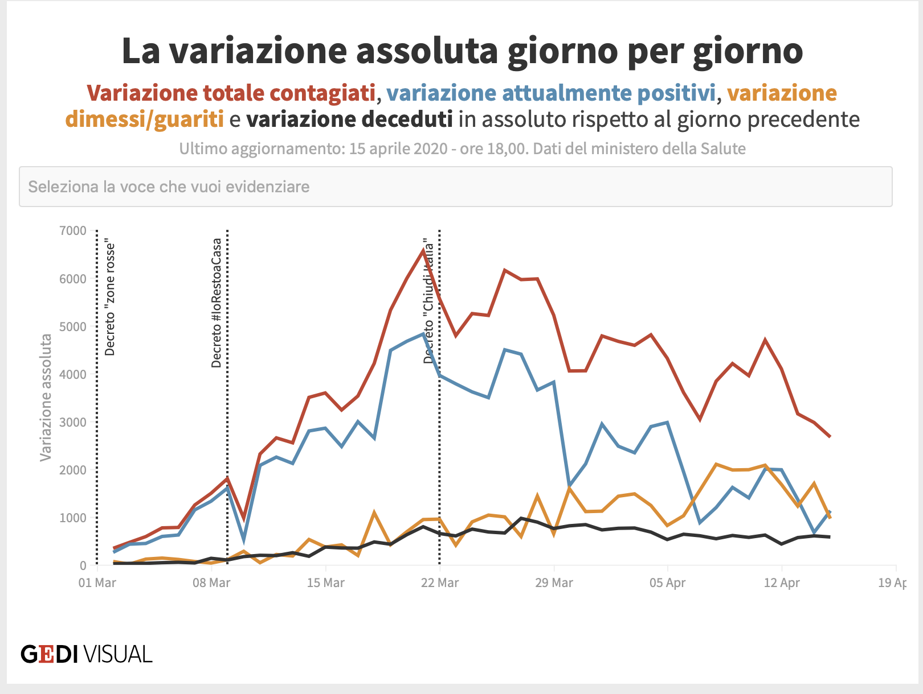
Let’s take a closer look: Daily variation in three metrics
https://lab.gedidigital.it/gedi-visual/2020/coronavirus-i-contagi-in-italia/?ref=RHPPTP-BH-I250745935-C12-P8-S1.3-T1

Slide 18
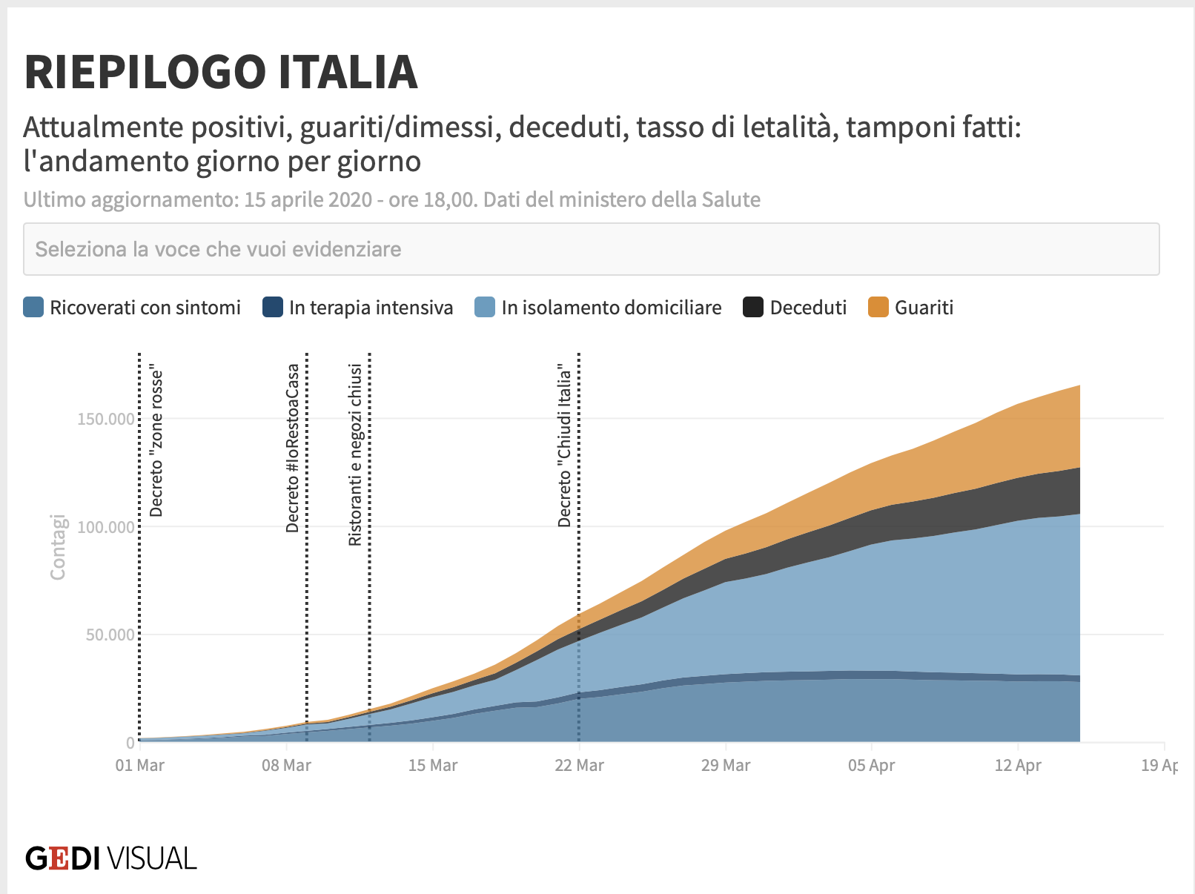
Summary curves
https://lab.gedidigital.it/gedi-visual/2020/coronavirus-i-contagi-in-italia/?ref=RHPPTP-BH-I250745935-C12-P8-S1.3-T1

Slide 19
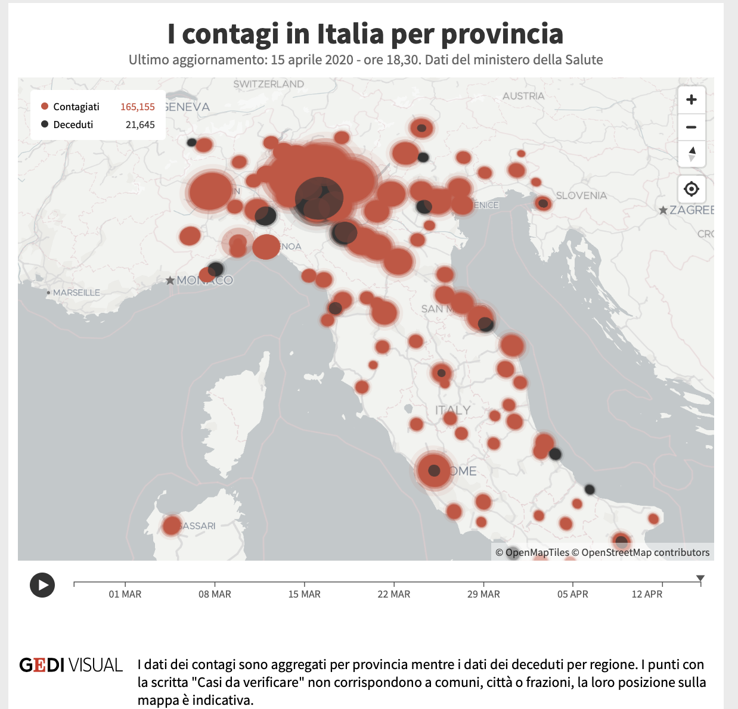
Diffusion of COVID-19 by province
https://lab.gedidigital.it/gedi-visual/2020/coronavirus-i-contagi-in-italia/?ref=RHPPTP-BH-I250745935-C12-P8-S1.3-T1

Slide 20
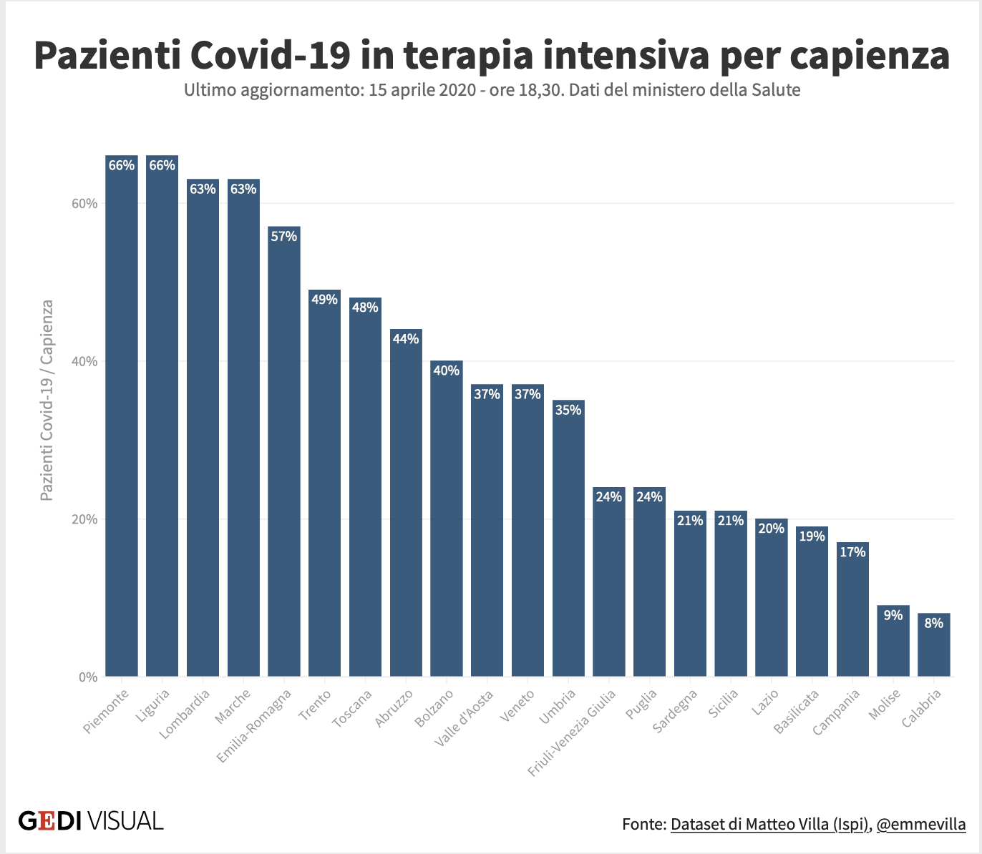
Proportion of ICU beds used for COVID-19
https://lab.gedidigital.it/gedi-visual/2020/coronavirus-i-contagi-in-italia/?ref=RHPPTP-BH-I250745935-C12-P8-S1.3-T1

Slide 21
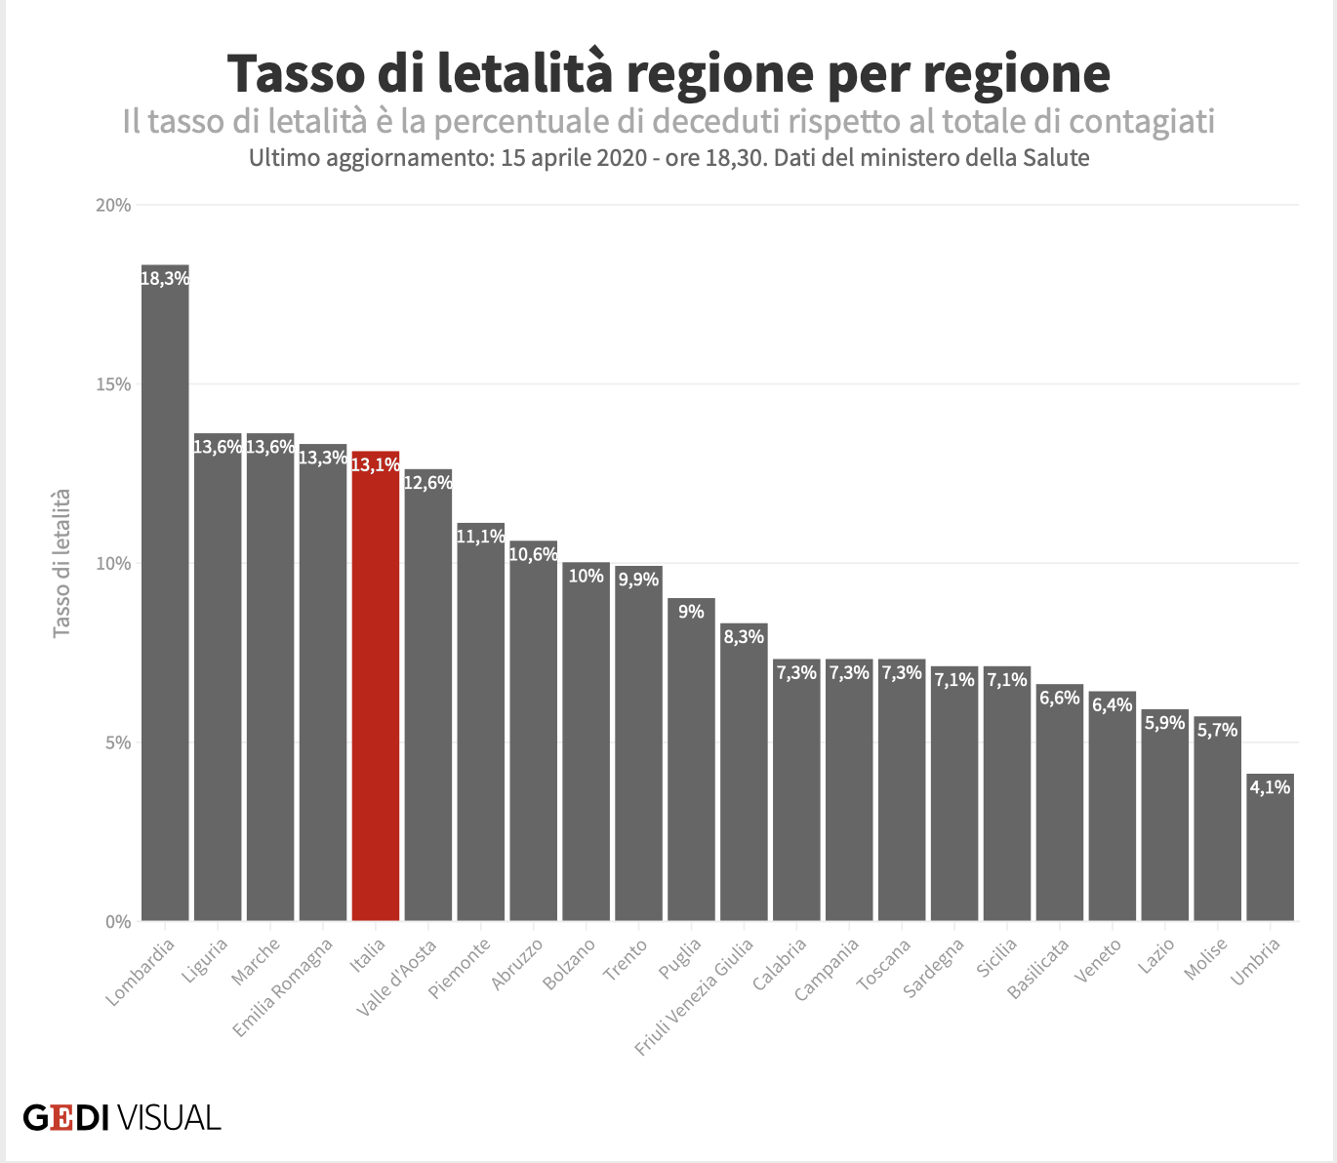
Mortality rate of COVID-19 by region
https://lab.gedidigital.it/gedi-visual/2020/coronavirus-i-contagi-in-italia/?ref=RHPPTP-BH-I250745935-C12-P8-S1.3-T1

Slide 22
So what is going on with Lombardy?
Geography
Apennines to the West, Alps to the North
Large basin effect
Weather
Thermal inversions
Wet, foggy autumns and early winters
Hot, humid summers
Population density
Crowded cities
Pollution
Most airborne particulates in Italy and much of Europe
Probable high rate of chronic lung diseases

Slide 23
Is that all, though?
Nursing homes
Two large nursing homes in Lombardy had many deaths: super-spreader effects
Up to 50% of COVID-related deaths occurred in or from nursing homes (EU-wide)
Structure of Italian healthcare system
Centralized in the regions, further centralized in provinces
Variability in access to care
Puzzle: Why aren’t there more cases in the South?
Population density
Nursing homes
Elderly patients in hospital

Slide 24
So what is daily life like here?
Still under lockdown
You still need to carry the ”auto-certificazione” at all times
But on Easter weekend, over 20,000 citations for violating the order!
Slow reopening beginning April 13
Some industry
Children’s clothing stores
Bookstores
May 4: target for relaxing the stay-home order

Slide 25
But not in Lombardy!!
Most industry, bookstores, and children’s clothing shops remain closed
Masks are required for everyone in public
400 Euro fine for violators
Target for the soft re-opening: May 4
Industry, bookstores, children’s clothing stores
Schools
Some restaurants, meeting criteria for seating

Slide 26
It is still empty in Pavia!
https://www.nytimes.com/2020/03/06/business/europe-coronavirus-labor-help.html

Slide 27
Mitigation efforts worldwide
Distancing
Rapid tests
Antibody assays
Clinical trials
Modeling

Slide 28
Let’s open this up for discussion!
Please add your questions in the chat box

